Slide 1
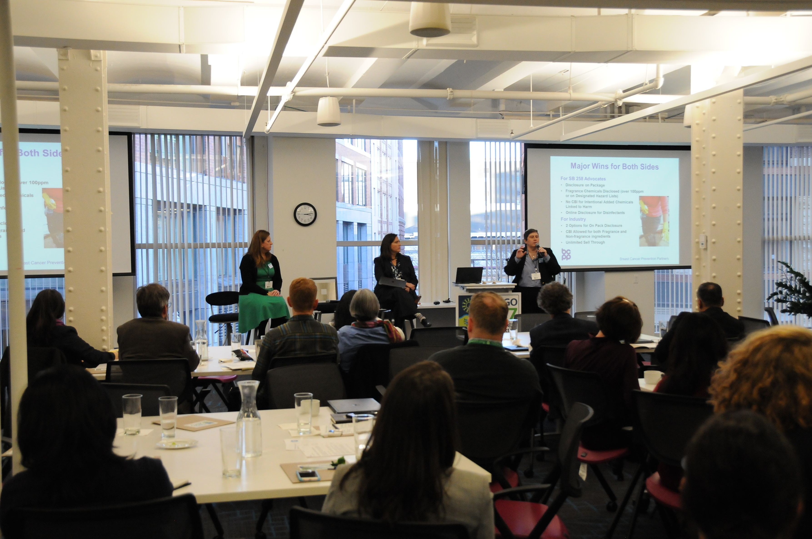


BizNGO 2020 15th Annual Meeting
It looks a little different this year but we’re so happy to have you!

Slide 2
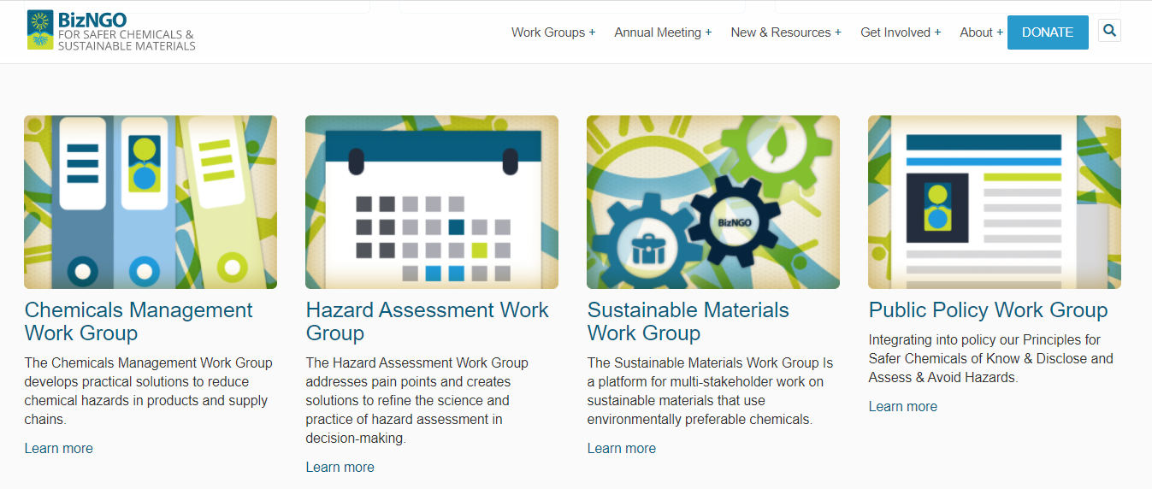
Solutions to PFAS in
Contact: Cheri Peele Contact: Shari Franjevic Food Service Ware Contact: Mark Rossi
cheri@cleanproduction.org shari@cleanproduction.org Contact: Kayla Williams mark@cleanproduction.org
kayla@cleanproduction.org

Slide 3


Thank you to our sponsors!

Slide 4

BizNGO 2020 – December 9
Taking on the challenges to chemical ingredient disclosure (11am-2pm EST)
Getting ahead of chemical classes (3-6pm EST)

Slide 5

Chatham House Rule
Participants are free to use the information received, but neither the identity nor the affiliation of the speaker(s), nor that of any other participant, may be revealed; unless approved by the participant

Slide 6
Meeting Logistics
Presentations will be recorded
Breakouts, Q&A, & report backs will not be recorded
PPTs will be posted online
If something goes wrong contact
Kayla 781.391.6743 x120
Ellen 781.391.6743 x102

Slide 7
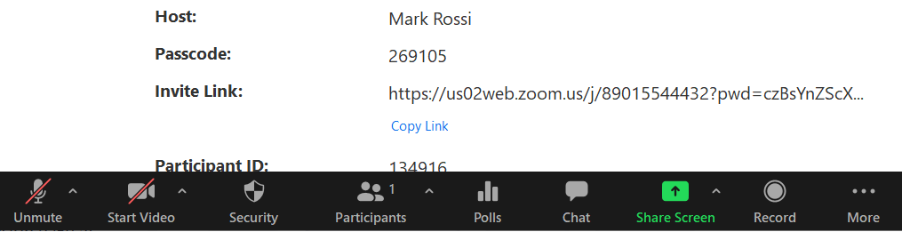

Zoom Protocol
Mute yourself when not speaking
Raise hand to verbally ask a question
Chat questions & comments
Video, feel free to show yourself :)
Rename yourself to include your organization

Slide 8



Session 3 Taking on the challenges to chemical ingredient disclosure

Slide 9
BizNGO Principles for Safer Chemicals
Know & DISCLOSE product chemistry
Assess & avoid hazards
Support public policies & industry standards
Commit to continuous improvement
Notes:
Beautycounter, Dignity Health (CommonSpirit), HP, KP, Naturepedic, Novation (Vizient), Seventh Generation, Shaw, Whole Foods Market

Slide 10
Transparency Rising
Children’s products (ME, NY, OR, VT, WA)
Disclose chemicals of concern
Cleaning products
California Cleaning Product Right to Know Act of 2017 (SB 258)
New York Household Cleansing Product Information Disclosure Program
Personal products
California SB 312—Cosmetic Fragrance and Flavor Ingredient Right to Know Act of 2020
California Professional Salon Product Ingredient Disclosure (AB 2775)
New York Menstrual Products Right to Know Act of 2019
Building products
Health Product Declaration (HPD) Open Standard, Version 2.2
Multiple product categories—Safer products for WA; Mercury disclosure

Slide 11

Session 3—Desired Outcomes
Identified key challenges to chemical ingredient disclosure for businesses, NGOs, and governments
Shared solutions—resources, tools, strategies, and tactics—for solving the challenges
Brainstormed list of potential roles for BizNGO on disclosure in 2021

Slide 12
Chemical Ingredient Disclosure
1st half
11:00 Welcome
11:10 Panel
11:40 Discussion: challenges; solutions; & role for BizNGO
11:50 Small groups—randomly assigned
12:15 Break

Slide 13
Chemical Ingredient Disclosure
2nd half
12:45 Report backs
1:00 Breakouts—your choice:
1) Fragrance disclosure
Facilitated by Tim Greiner, Pure Strategies &
Janet Nudelman, Breast Cancer Prevention Partners
2) Supply chain disclosure
Facilitated by William Paddock, WAP Sustainability Consulting
3) Non-functional constituents/impurities disclosure
Facilitated by Margaret Whittaker, ToxServices
1:35 Report backs
1:50 Q&A
2:00 Adjourn

Slide 14
Poll #1—What are your greatest challenges to chemical ingredient disclosure (check all that apply)?
SUPPLY CHAINS, getting information from them
CBI (Confidential Business Information) claims
100% DISCLOSURE of INTENTIONALLY ADDED CHEMICALS by homogeneous material
Disclosure of FRAGRANCES/COLORANTS/FLAVORS
DISCLOSURE of NON-FUNCTIONAL CONSTITUENTS / RESIDUALS / IMPURITIES
THRESHOLDS for disclosing NON-FUNCTIONAL CONSTITUENTS / RESIDUALS / IMPURITIES
PUBLIC ACCESS to chemical ingredient information in products / ON-PACKAGE DISCLOSURE
LACK OF STANDARDIZATION of disclosure formats across sectors and governments
DISCLOSURE OF HAZARDS of the chemicals in the products
ENFORCEMENT of product disclosure: either doing it or lack thereof

Slide 15



Speakers
Bobbi Wilding,
Deputy Director,
Clean and Healthy New York
Terri Goldberg,
Executive Director,
NEWMOA
Jon Smieja,
Corporate Sustainability Manager,
Andersen Windows
11:10-11:40
type your questions in chat

Slide 16


BizNGO – IC2 Chemical Ingredient Disclosure Principles December 2020

Slide 17
December 2019 Meeting
Successful stakeholder meeting in Cambridge, MA to initiate process for developing a set of Chemical Ingredient Disclosure Principles; followed 2019 BizNGO annual meeting
Participants:
State & local representatives from CA, MA, MN, NY, OR, WA, SF, King County, OR Metro
Companies, including RB, Google, GOJO, Clorox, Human Scale, Anderson, Seventh Generation, Milliken, & more
NGOs, including Clean & Healthy NY, Breast Cancer Prevention, Women’s Voices for the Earth, Toxic-Free Future, Center for Environmental Health, NRDC, HPD, & more
Purpose: To initiate the development of a set of principles for ingredient disclosure to help inform future programs & policies to which a wide array of stakeholders can agree

Slide 18
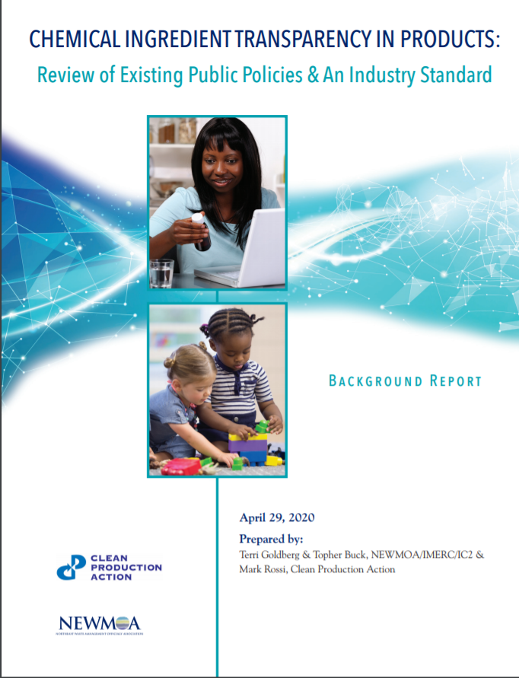
IC2 – CPA Report https://www.theic2.org/article/download-pdf/file_name/IC2-CPA_ChemicalDisclosure_ReviewPaper_FINAL.pdf

Slide 19
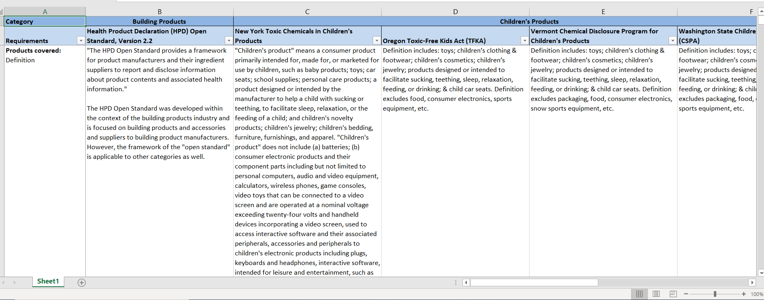
Spreadsheet Download from https://www.theic2.org/publications

Slide 20
Developing Principles: Overall Questions
Aspirational?
How operational?
Definitions of key terms
Challenges with information flow/access within supply chains
Principles Plus Guidance

Slide 21
Key Issues Debated in Developing Principles
Reporting on intentionally added ingredients
Non-functional ingredients/incidental ingredients/contaminants
Criteria for specifying chemicals of concern for disclosure
Confidential business information (CBI)
Data gaps & need for improved/complete hazard information

Slide 22
Reporting on Intentionally Added Ingredients
Thresholds for disclosure of intentionally added ingredients or none?
Hazard characteristics?
The children’s product requirements set the limits disclosure of intentionally added ingredients as the practical quantification limit (PQL)
The HPD Open Standard allows companies to report to different threshold levels, including 100 ppm & 1,000 ppm
“Disclose all intentionally added chemical ingredients. Disclosure comprises identity of the chemical ingredient, including name(s), CAS registry number, function, presence on specified lists of chemicals of concern, & other chemical hazard characteristics of the ingredient.”

Slide 23
Definition of Intentionally Added Ingredient
“a chemical that a manufacturer has intentionally added to a designated product & that has a functional or technical effect in the designated product, including, but not limited to, the components of intentionally added fragrance ingredients & colorants & intentional breakdown products of an added chemical that also have a functional or technical effect in the designated product” (Source: State of California, Senate Bill No. 258, Cleaning Product Right to Know Act, October 15, 2017)

Slide 24
Non-functional Ingredients
Significant debate on the definition
“Nonfunctional constituent: a chemical that has no functional or technical effect on the designated product & is present as an incidental component of an intentionally added ingredient, a breakdown product of an intentionally added ingredient, or a byproduct of the manufacturing process.”
“Incidental component:
(1) a chemical which was added during the manufacturing process at any point in a product, a raw material, or an ingredient’s supply chain, but which has no functional or technical effect in the finished product, including an unreacted chemical; or
(2) a chemical present in the environment as a contaminant which was introduced into a product, a raw material, or a product ingredient at any point in the supply chain for the product, raw material, or ingredient, as a result of the use of an environmental medium, such as a naturally occurring mineral, air, soil, or water, in the manufacturing process.”

Slide 25
Specifying Chemicals of Concern
Include reference lists from existing legislation?
More general – just list hazard characteristics?
“Chemicals of concern, i.e., substances that are known or suspected hazards to human health or the environment, including carcinogens, mutagens, reproductive/developmental toxicants, endocrine disruptors, asthmagens, & allergens… .”
“Specified list of chemicals of concern:
CA Cleaning Product Right to Know Act of 2017 (SB 258) Designated or CA Cosmetic Fragrance & Flavor Right to Know Act (SB 312)
ChemSec SIN List
GreenScreen List Translator LT-1 & Benchmark 1 chemicals
NY State Lists of Chemicals of Concern”

Slide 26
Chemical Hazard Characteristics
“Chemical hazard characteristics as defined by:
Globally Harmonized System (GHS) of Classification and Labeling hazard phrases (H-phrases) or
GreenScreen® for Safer Chemical and GreenScreen scores.
For example, H-phrases are contained within a GHS compliant Product Safety Sheet and/or can be separately shared; and GreenScreen scores are listed in Health Product Declarations (HPDs).”

Slide 27
Confidential Business Information (CBI)
Most of the existing state laws allow for some CBI (a.k.a. trade secret) claims
Examples of CBI include:
Specific chemical identities
Market-share data, such as the # of products sold in the U.S. or a state/year
Supply-chain relationships

Slide 28
CBI Debate
What should companies be able to claim as CBI?
Recognize need for certain level of CBI
“Signatories to these Principles recognize the need to protect CBI in limited situations when protection of the information is justified & substantiated.”
“Chemicals of concern, i.e., substances that are known or suspected hazards to human health or the environment… are not confidential business information”

Slide 29
Need for Improved Hazard Information
How do we interpret gaps in hazard data?
What’s good science?
“Advocate for filling data gaps by characterizing the hazards of chemicals. Chemicals lacking safety data can neither be assumed safe nor unsafe.”
“We support efforts by governments, businesses, universities, & NGOs to fill chemical hazard data gaps with scientifically validated characterizations of the hazards of chemicals, to use validated non-animal testing methods where appropriate, & to publicly share the findings.”

Slide 30
Contacts
Terri Goldberg – tgoldberg@newmoa.org
Melissa Nadeau – mnadeau@newmoa.org
Mark Rossi – mark@cleanproduction.org

Slide 31
Transparency from a Manufacturer’s perspective:
Challenges and solutions for the 21st century
Jon Smieja, PhD
Corporate Sustainability Manager
12/9/2020
BizNGO 2020 Session 3 – Transparency Panel

Slide 32
The supply chain nightmare
Spacer
Sealant
Wood treat
Primer
Coatings
Desiccant
Wood
Paint
Glass
Insulated Glass Unit
Sash
Cladding
Supplier 1
Supplier 1
Supplier 2
Hardware
Weather-stripping
Supplier 2
Window
Supplier 3
Supplier 3
Cladding
Frame
Install Materials
Foam
Paint
Wood
Tape
Screws
Primer
Wood treat

Slide 33
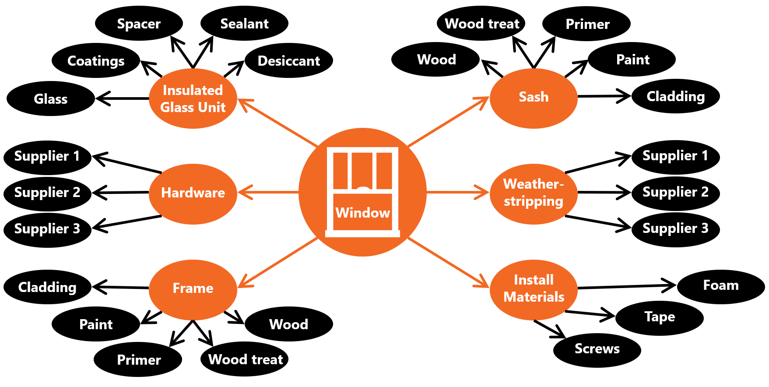
The nightmare expanded

Slide 34

How do we get out of the fog?
Set expectations early
Set expectations for customers
Be
(willing to be)
a gopher
Explain
Explain
Explain
Put a process in place

Slide 35
Thank You
Jon Smieja, PhD
Corporate Sustainability Manager
Andersen Windows & Doors
jon.smieja@andersencorp.com

Slide 36

Chemical Transparency: An Advocate's Perspective
Bobbi Wilding
Clean and Healthy New York
This Photo by Unknown author is licensed under CC BY-SA.

Slide 37
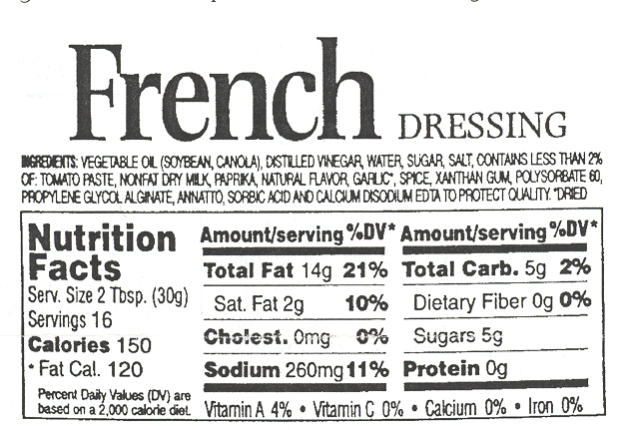
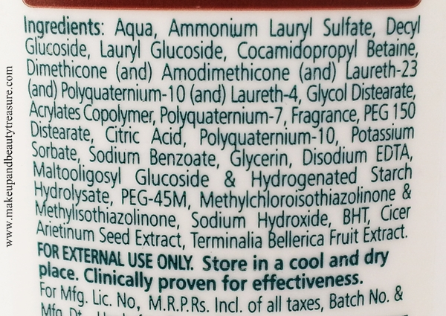

It's time for full transparency
This Photo by Unknown author is licensed under CC BY-SA.
This Photo by Unknown author is licensed under CC BY-NC-ND.

Slide 38
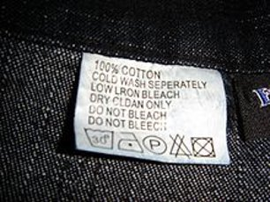


So much we don't know
This Photo by Unknown author is licensed under CC BY-NC.

Slide 39
And it matters
Dyes
Colorants
"Flavors"
Decorations
The additives in plastic bottles
PFAS in nonstick/waterproof coatings
Fixatives
Process aids
The basic material making up nearly any plastic toy
Heavy metals in solar panels...

Slide 40
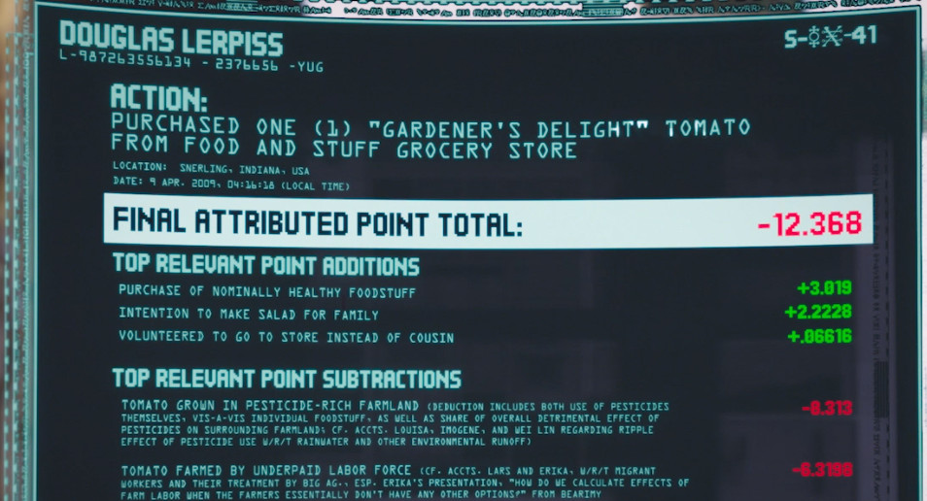
It's complicated: a lesson from The Good Place

Slide 41
Change is possible and needed
Common frameworks for disclosure are needed
Retailers can build momentum
Product maker and retail trade associations to develop common robust frameworks
Policy can create a cohesive landscape

Slide 42
Bobbi Wilding Clean and Healthy New York cleanhealthyny.org bobbi@cleanhealthyny.org 518-708-3875

Slide 43
Panel Discussion
11:40-11:50

Slide 44
Panel Discussion (continued)
curious to learn where (i'm assuming not always in the US)raw materials are coming from and the social, political, economic dynamics in which they/suppliers operate.
Sourcing outside of domestic country, more complicated; foreign suppliers, transparency is new; it’s a challenge
Where’s the point of advocacy in this work? Trade policies?
Mfrs trying to be transparent, doing responsible supply chain engagement – visit suppliers for week or more
It would be interesting to discuss the issue of an "expiration date" on disclosures. Material selection changes over time, and the disclosure will change accordingly. How often should disclosures be updated? HPDs, for example, have a 3 year shelf life.
3 yrs reasonable as long as mfr keeping track of material changes and updating the changes; new screw, not worth updating
Children safe products can be 1 year, 1 time reporting; need
have you found any appetite from trade associations to engage on the topic of developing these database infrastractures?
Unsure. Opportunity to have those discussions. Need to do this
BIFMA had a project to create a joint database
Mercury: some trade associations have been very effective and cooperative; and others were not
Screws, etc., always important to know what’s in the little things because of lifecycle concerns, both upstream and downstream
11:40-11:50

Slide 45
Panel Discussion (continued)
curious to learn where (i'm assuming not always in the US)raw materials are coming from and the social, political, economic dynamics in which they/suppliers operate.
Sourcing outside of domestic country, more complicated
11:40-11:50

Slide 46
Small Groups
Need
Report back
Note taker: https://docs.google.com/document/d/1eGBWnKMCFk5rYqN-Ge6oiA7FzqyGZCUQKjEOoKicEC0/edit?usp=sharing
Questions
Quick introductions: Name, organization, and where are you calling in from?
What are your challenges in chemical ingredient disclosure?
How are you trying to solve them?
What role(s) could BizNGO play in helping to solve them?
11:55-12:20

Slide 47
Break!
12:45 EST time to return

Slide 49
BizNGO 2020 15th Annual Meeting
It looks a little different this year but we’re so happy to have you!

Slide 50
Chemical Ingredient Disclosure
2nd half
12:45 Report backs
1:00 Breakouts—your choice:
1) Fragrance disclosure
Facilitated by Tim Greiner, Pure Strategies &
Janet Nudelman, Breast Cancer Prevention Partners
2) Supply chain disclosure
Facilitated by William Paddock, WAP Sustainability Consulting
3) Non-functional constituents/impurities disclosure
Facilitated by Margaret Whittaker, ToxServices
1:35 Report backs
1:50 Q&A
2:00 Adjourn

Slide 51
Report Backs
Challenges
Getting info at all
SDSs don’t have ingredients
Multiple formats
Supply chain / Suppliers not sharing
Brands not asking / requiring
Lack of regs/requirements and public accountability
Recycled content
1-size doesn’t fit all, eg, differences across sectors & product types
Solutions
Using EPEAT or GreenScreen BM scores for hazard information; transfer haz info without trnasferring
Supply chains: Blind supply chain; Working with supply chains
BizNGO: Standardizing reporting frameworks by sector; advocate for entire sectors; recruiting more cosmetic companies; bring large brands to the table and campaigns within the working group;
Sector approach
EU Green Deal & Chemicals Strategy
Why no GHS for consumer products in the U.S.?
Cleaning products models: CA and NY; more restrictive CBI requirements
Required to put page on website with all intentionally added products
Leverage buying power; big brands / retailers
Public accountaility: campaigns, scorecards
Regs can be a catalyst
Defaults on certain chemicals or chemical classes
12:45-1:00

Slide 52
Report Backs (continued)
Challenges
Misled by expectation that articles & formulated products should have the same level of disclosure
Don’t pay enough attn to implementation; how feasible is it to collect the information
Not readily available
inconsistent info (eg, CA + NY cleaning product requirements)
Pay attention to what we need; don’t let perfect be the enemy of the good
Setting priorities and different requirements across the globe
Different purchasers within an org
Fragrances
Sub-suppliers where it gets most difficult
Solutions
Standardized requirements within sectors
Retailers
3rd parties in gathering data
Personal care as starting point; making it useful; chemical and lists of chemicals of concern
Tools for secure disclosure across supply chain; value of disclosure to sub-suppliers
Drivers: brands, retailers, requiring disclosure and why info is needed
Sectors for bizngo? Chemical companies; Plastic mfrs; Adhesives/coatings; private equity, evaluating risks and data
12:45-1:00

Slide 53
Report Backs (continued)
12:45-1:00

Slide 54
Breakout Sessions
Fragrance disclosure
Non-functional constituents / impurities disclosure
Supply chain disclosure
1:00-1:35

Slide 55
Non-Functional Constituents (NFCs) / Impurities / Residuals—Questions
Questions:
What are the key challenges (e.g., definition, scope of chemicals of concern, thresholds)?
Where are the successes? Personal care products, cosmetics
Mimic those successes in other sectors
Have businesses/NGOs/gov’ts found common ground on definition?
Why is it hard to find common ground on scope & thresholds?
Thresholds changing, new technology for testing keeps getting better (eg, lead as impurity of concern in steel)
Where are the conversations happening?
Scope and thresholds on the agenda in NY State for cleaning products
Health Product Declaration Collaborative (HPDC)
Where else?

Slide 56
Definitions: NFC & Incidental Component
Nonfunctional constituent:
“is an incidental component of an intentionally added ingredient, a breakdown product of an intentionally added ingredient, or a byproduct of the manufacturing process that has no functional or technical effect on the designated product” As defined by CA Cleaning Product Right to Know Act of 2017 (SB 258)
Incidental component:
a chemical which was added during the manufacturing process at any point in a product, a raw material, or an ingredient’s supply chain, but which has no functional or technical effect in the finished product, including an unreacted chemical [NY State-“nonfunctional byproduct”];
Knowingly added to the mfg process (eg, catalysts added to plastic)
a chemical present in the environment as a contaminant which was introduced into a product, a raw material, or a product ingredient at any point in the supply chain for the product, raw material, or ingredient, as a result of the use of an environmental medium, such as a naturally occurring mineral, air, soil, or water, in the manufacturing process. [NY State-“nonfunctional contaminant”]
Impurities in the raw materials (eg, lead in steel)

Slide 57
HPDC—definitions
"Impurity: an unintended substance present in a material/mixture as manufactured that was not an intentionally used substance in the production of the material/mixture. It may originate from the starting materials or be the result of secondary or incomplete reactions during the manufacturing process. For example, a chemical substance as supplied in commerce that is 99.0% pure is a mixture of the pure chemical substance and 1.0% impurities."
"Residual: an Intentionally Used Substance that may be present in the final material/mixture but which is not intended as a constituent. For example, this may refer to substances included in a manufacturing process to aid processing, as well as inputs to a reaction process such as reagents, catalysts, or monomers."

Slide 58
Scope & Threshold
CA SB 258 (Cleaning Product Right to Know Act):
Prop 65: no threshold if triggers a product warning pursuant to that act
34 chemicals
100 ppm (1,4-dioxane 10 ppm)
New York Household Cleansing Product Information Disclosure Program [under revision]:
Same as CA until 2023, then all nonfunctional ingredients present on a list of chemicals of concern (Appendix B list of lists, 29 lists--https://www.dec.ny.gov/docs/materials_minerals_pdf/cpidbmps.pdf)
If byproduct: Practical Quantitation Limit (PQL)
If contaminant, a hierarchy of:
NY MCLs for drinking water
CA Prop 65 trigger level
50 ppb
Special exceptions:
1,4 dioxane: 350 ppt
PFOA & PFOS combined: 70 ppt

Slide 59
Notes: NFCs—Challenges
Definitions
Alignment of definitions
But don’t know if they have it in their products; esp reaction byproducts (eg, dying: buffering agents, extenders, etc.; multistep processes lead to different byproducts)
By on function and performance, but don’t care about byproducts
..
Scope of chemicals covered
Thresholds
What are the NFCs? Do suppliers know?
Don’t know byproducts
A differentiator among suppliers
Differences between companies knowing/asking for NFCs
Some companies that know, because they asked or tested, are at a disadvantage to those who don’t know
“Transparency washing”:

Slide 60
Notes NFCs
Recycled content is a huge challenge to know what’s in it. Circular economy, how do we know what’s in that material?
Living Product Challenge developing rules; need aligned rules
Definitions clear re byproducts and contaminants, but recycled content is a real challenge
Contaminants are really hard to know; whereas byproducts (eg, 1,4-dioxane, and small amounts matter) are typically known
Cross fertilization across sectors, definitions, thresholds?
What can we learn and share about contaminants and byproducts from across sectors and geographies
HBN Pharos
Priority asthmagen list
Deep dive in process chemistry
What’s in building products
Product testing: how much, sharing results
Concern: what are we testing for; how often does testing occur
Multiple suppliers of one product/material; sourcing same raw material from 3 suppliers but can have different contaminants and byproducts
1:00-1:35

Slide 61
Notes NFCs
Recycled content!
Alignment to how to address content needed
Generally acknowledged contaminants / byproducts
Bodies of knowledge, but not compiled
Mostly focused on polymers
HBN for built environment
Test methods should be publicly made
High level
1,4-dioxane poster child
Recycled content huge challenge
Don’t know what’s in it
Disclosure by product sector
Generally acknowledged contaminants / byproducts by function, geography
Go to labs for product testing
Listing of labs
Thesholds: be wary of using risk to set disclosure levels for NFCs; about looking for alts; hard to find thresholds without using risk; what’s possible and practical
1:00-1:35

Slide 62
Notes NFCs
1:00-1:35

Slide 63
Report Backs & Discussion
Fragrances
CA law, regulatory push
Brands pushing to disclosure
Increased cooperation from fragrance houses
Challenge to 0.1% or 0.01% (Unilever-https://www.unileverusa.com/news/press-releases/2019/unilever-completes-landmark-fragrance-disclosure.html) of fragrance
Clear need for disclosure, # of chemicals, chemicals of concern
Need big companies to lift bar for everyone
Small companies (e.g., companies in Credo) making full disclosure the new normal
Biz’s and NGOs need to work together on regulatory pushes
Disclosing flavors as well; positively changing environment
https://credobeauty.com/collections/radical-fragrance-transparency
1:35-2:00

Slide 64
Report Backs & Discussion (continued)
Supply chains
Challenges of small (lack of leverage) v lg co’s
Is it really CBI? Missing is justification of CBI
HPD: don’t need justification
Base definition of transparency; standardized agreement; standardized across sectors
Where in the supply chain should the transparency sit?
Supply chain case studies? Any value?
Facilitate best practice sharing; successes
1:35-2:00

Slide 65
Report Backs & Discussion (continued)
1:35-2:00

Slide 66
Poll #2
What are your preferred solutions to the challenges of disclosure?
ALL PRODUCTS: government requirement to disclose all intentionally added chemicals in all products
ALL PRODUCTS: one voluntary standard for disclosure across all product types and sectors
BY INDUSTRY SECTOR: government disclosure requirements by industry sector
BY INDUSTRY SECTOR: voluntary standards such as HPD or SmartLabel
RETAILERS REQUIRE CHEMICAL INGREDIENT DISCLOSURE of all products on their shelves
GOVERNMENTS REQUIRE CHEMICAL INGREDIENT DISCLOSURE for all products they purchase
NON-FUNCTIONAL CONSTITUENTS / RESIDUALS / IMPURITIES: must be disclosed for chemicals on authoritative lists (e.g., REACH SVHCs)
HAZARD DATA: chemical ingredient disclosure should include hazard characterization of the chemicals in the products
OTHER: solution not proposed above

